Slide 1
Modeling the pandemic – The transition toward endemicity
Because of the pandemic of COVID-19, governments around the world resorted to unprecedented measures, such as lcokdowns and curfews, for 2 years
Does that mean that this is the new normal and that those policies are going to come back periodically to deal with COVID-19?
No, because SARS-CoV-2 is going to become endemic, which doesn’t seem that it will stop killing people (even a lot of people) but does mean that it will become less dangerous
In this lecture, we are going to see what it means for a virus to become endemic, and why it means that it becomes less dangerous

Slide 2
Modeling the pandemic – The transition toward endemicity
The dangerousness of a virus depends on both how transmissible it is and how virulent it is
A virus can be more dangerous than another, less virulent one if it’s sufficiently more transmissible and vice versa
It’s also important to distinguish the actual dangerousness of a virus from its potential dangerousness and this distinction is key to understand why a virus becomes less dangerous as it reaches endemicity

Slide 3
Modeling the pandemic – The transition toward endemicity
Indeed, both the actual transmissibility and the actual virulence of a virus depends on, among other things, the proportion of the population that has some kind of immunity against it
The more people have some kind of immunity against it, the less transmissible and the less virulent it is, even if its intrinsic transmissibility and virulence haven’t changed
When a new virus emerges, the population is immunologically naive, which means that nobody has any immunity against it other than innate

Slide 4
Modeling the pandemic – The transition toward endemicity
In such a population, a virus is maximally dangerous and will generally do a lot more damage than when a large share of the population has already been exposed to it and has developed some immunity against it
Examples:
Indigenous populations in America when Europeans first arrived and brought Old World viruses with them
Every country in the world in 2020 when SARS-CoV-2 emerged
That’s because when the population is immunologically naive, it’s easier for the virus to spread and infect more people and the people who are infected are more likely to get seriously ill

Slide 5
Modeling the pandemic – The transition toward endemicity
At the beginning of the pandemic, a lot of people argued that SARS-CoV-2 was “just like the flu”
It wasn’t: in France, the flu is estimated to kill between 5,000 and 15,000 people each year, but SARS-CoV-2 killed ~65,000 people in 2020 alone and another ~60,000 in 2021
But the population was immunologically naive, so the same virus will kill less people in the future, as more and more people have some immunity against it (because they have been vaccinated, infected or both)
In other words, what made SARS-CoV-2 worse than the flu was — at least in part — the fact that it was novel

Slide 6
Modeling the pandemic – The transition toward endemicity
Eventually, as more people become immune, we reach what is called an endemic equilibrium
In a compartmental model, this state is reached when incidence stops changing and remains at the same level greater than zero forever, but in reality this never happens viruses are affected by the weather, new variants emerge, etc.
In practice, there is no precise definition of what it means for a virus to become endemic, but roughly we can say that it’s reached when enough people have infected or vaccinated, possibly several times, that keeping everything else equal (people’s behavior, climate, the genetic code of the virus, etc.) the virus would infect approximately the same proportion of the population every year
When a virus has become endemic in that sense, and even before that as it moves toward endemicity, it becomes less dangerous because it spreads less and a lower proportion of the people it infects become seriously ill

Slide 7
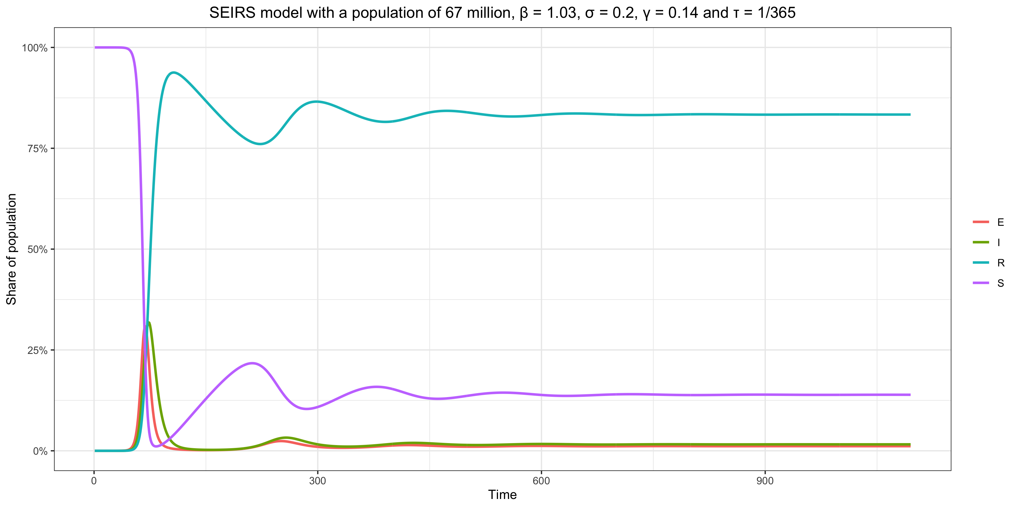
Modeling the pandemic – The transition toward endemicity
Example of endemic equilibrium in a SEIRS model

Slide 8
Modeling the pandemic – The transition toward endemicity
Suppose a new virus is introduced in a population of 10 million (3 million people between 0 and 18 years old, 4 million people between 19 and 59 people and 3 million people 60 and over)
IFR = 0.05% for 0-18, 0.2% for 19-59 and 1% for 60+
25% of each age group is infected during the first year
So it kills 25% * 3,000,000 * 0.05% + 25% * 4,000,000 * 0.2% + 25% * 3,000,000 * 1% = 9,875 people the first year

Slide 9
Modeling the pandemic – The transition toward endemicity
Same population but 25% of 0-18 are immune and 100% of the rest of the population is
Immunity is 80% effective against death and this doesn’t vary by age
15% of 0-18, 10% of 19-59 and 5% of 60+ are infected in a year
So it kills 15% * 3,000,000 * (1 – 80%) * 0.05% + 10% * 4,000,000 * (1 – 80%) * 0.2% + 5% * 3,000,000 * (1 – 80%) * 1% = 640 people in a year
That’s more than 15 times less than before, but by assumption the virus is exactly the same and, in particular, its intrinsic dangerosity is the same!

Slide 10
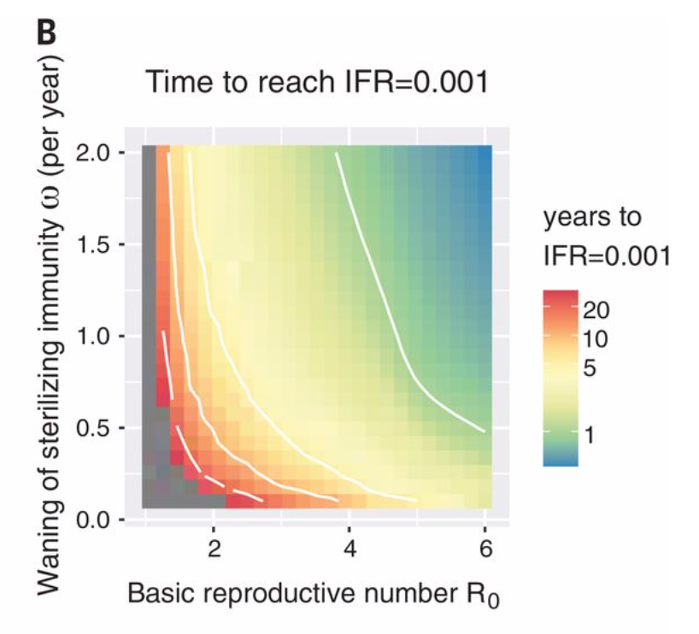
Modeling the pandemic – The transition toward endemicity
If you model this, you see that the speed of the transition depends on the properties of the virus
Lavine et al., “Immunological characteristics govern the transition of COVID-19 to endemicity”, Science, 2021

Slide 11
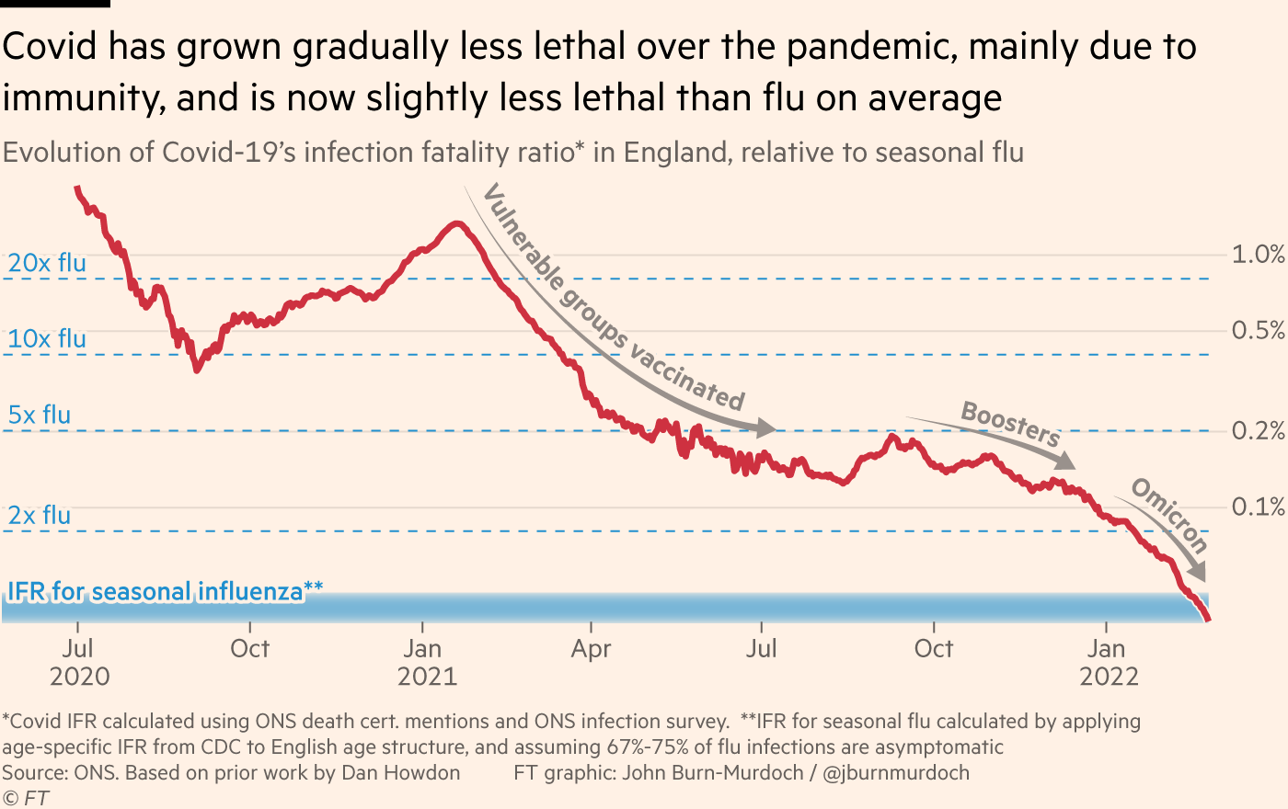
Modeling the pandemic – The transition toward endemicity
Something like that has actually been happening with SARS-CoV-2

Slide 12
Modeling the pandemic – The transition toward endemicity
So despite a common misconception, if a new virus becomes less dangerous as it reaches endemicity, this is not because it mutates in a way that makes it less intrinsically dangerous
This may happen, but there is nothing automatic about it and the argument that people usually advance to the contrary is flawed
In other words, we basically got lucky with Omicron, because there was no reason for a less virulent variant to emerge

Slide 13
Modeling the pandemic – The transition toward endemicity
The emergence of new variants may make some years worse than others, as we see with the flu, but it’s very unlikely to bring us back to square one
Evolution is too slow and gradual for that, so in practice people’s immunity will get “updated” regularly by reinfection or vaccination
This is already what is happening with the other 4 human coronaviruses that are endemic in human populations, cf. Eguia et al. (2021) on HCoV-229E
It’s too early to know exactly how bad SARS-CoV-2 will be, but it won’t be nearly as bad as during the pandemic because it won’t be novel anymore

